Slide 1
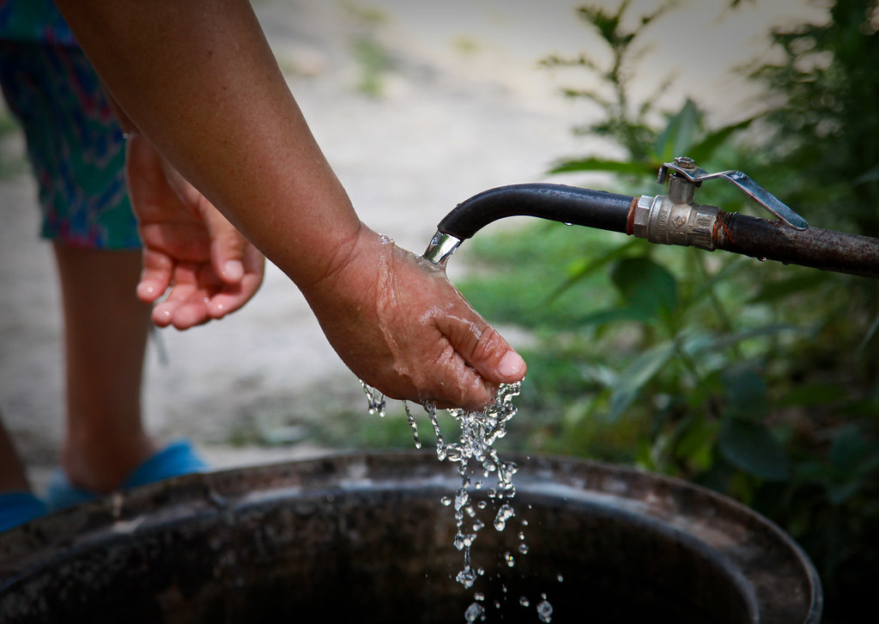
Punjab Cities Program Data Submission - IBNET
Punjab Municipal Development Fund Company
January 25, 2024

Slide 2
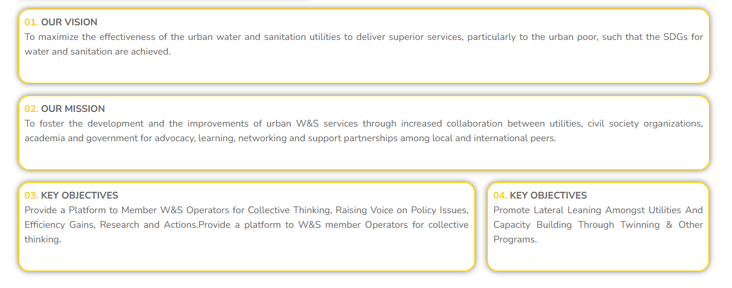
Key Objectives
Chairman: Syed Zahid Aziz
MD/PD (PMDFC – PCP)
CEO (Aab-e-Pak Authority)

Slide 3
What is IBNET
The New International Benchmarking Network for Water and Sanitation Services (New IBNet)
Independently designed to become global information system and partnership.
New IBNet will invite utilities and other service providers, regulators and researchers, to systematically share data on service delivery performance and on management practices.
Based on such data, New IBNet will offer analyses and other data-based services that will allow IBNET members – water and sanitation service providers, regulators, and others – to take informed decision, including on management action and on investments, and thus to improve their performance.

Slide 4
Offerings with IBNET
1. Data services for Utilities
Online data repository with consistency checks and custom reports
Insightful comparisons between utility performance benchmarked with others
Find and connect with others based on a similar context as yours
Community of Learning to connect and learn from others
Data services for Utilities
Data services for Regulators
Data services for Development Planners

Slide 5
Core Indicators Performance

Slide 6
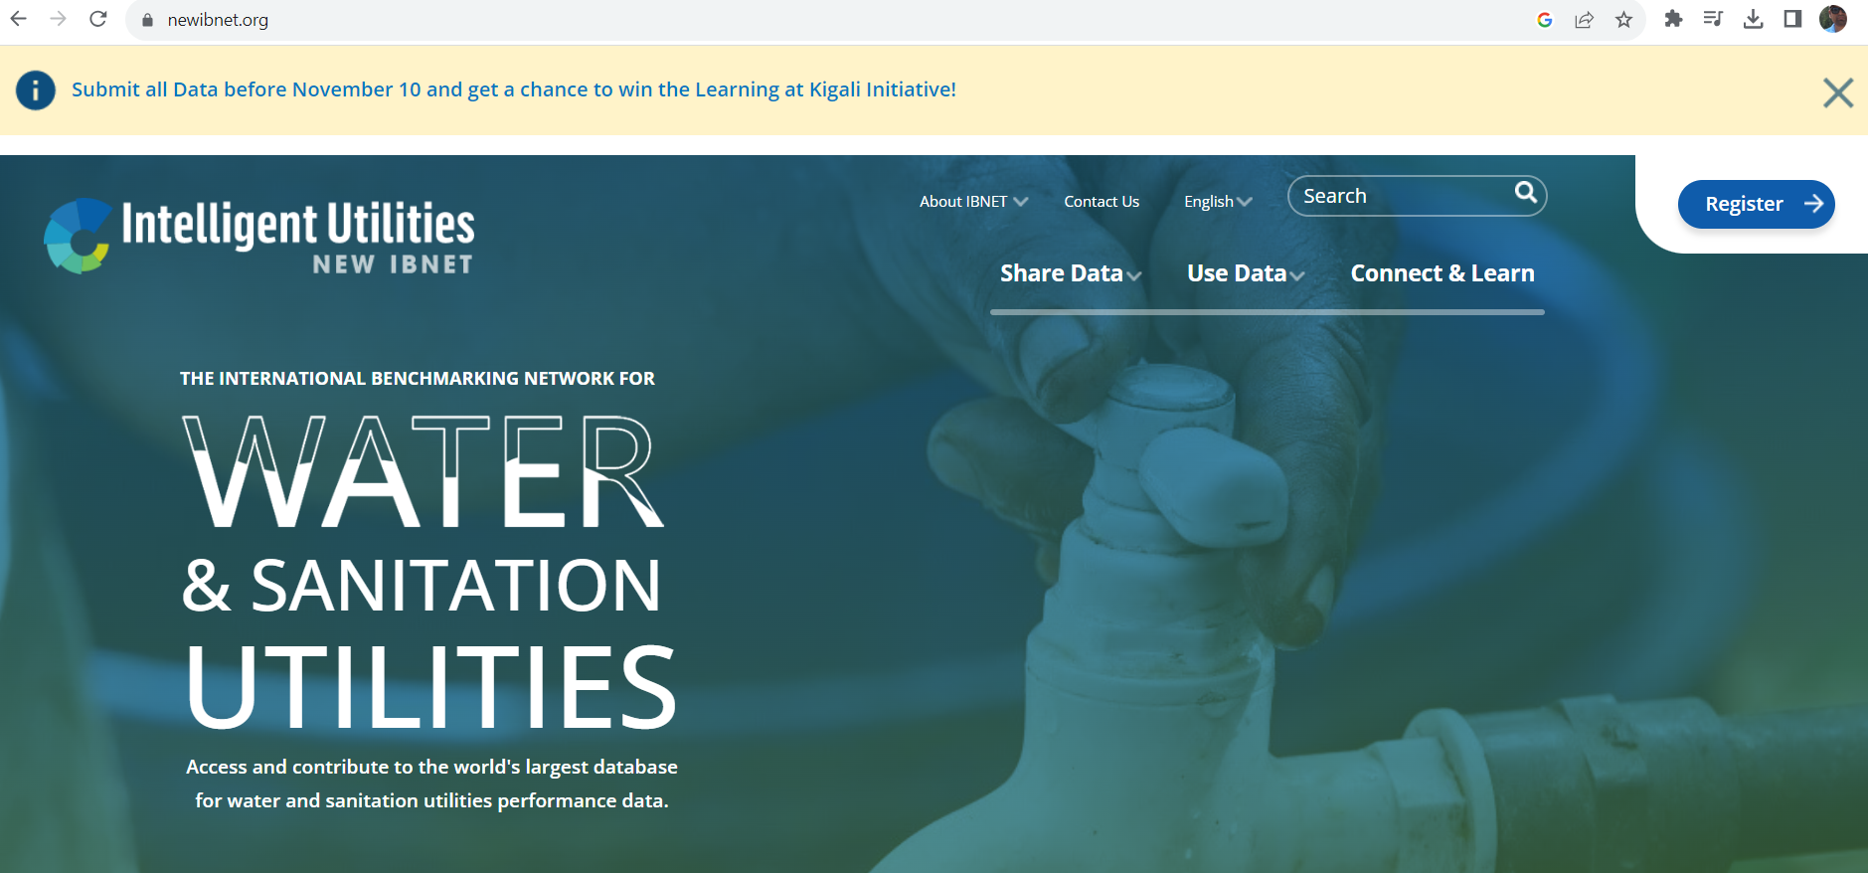
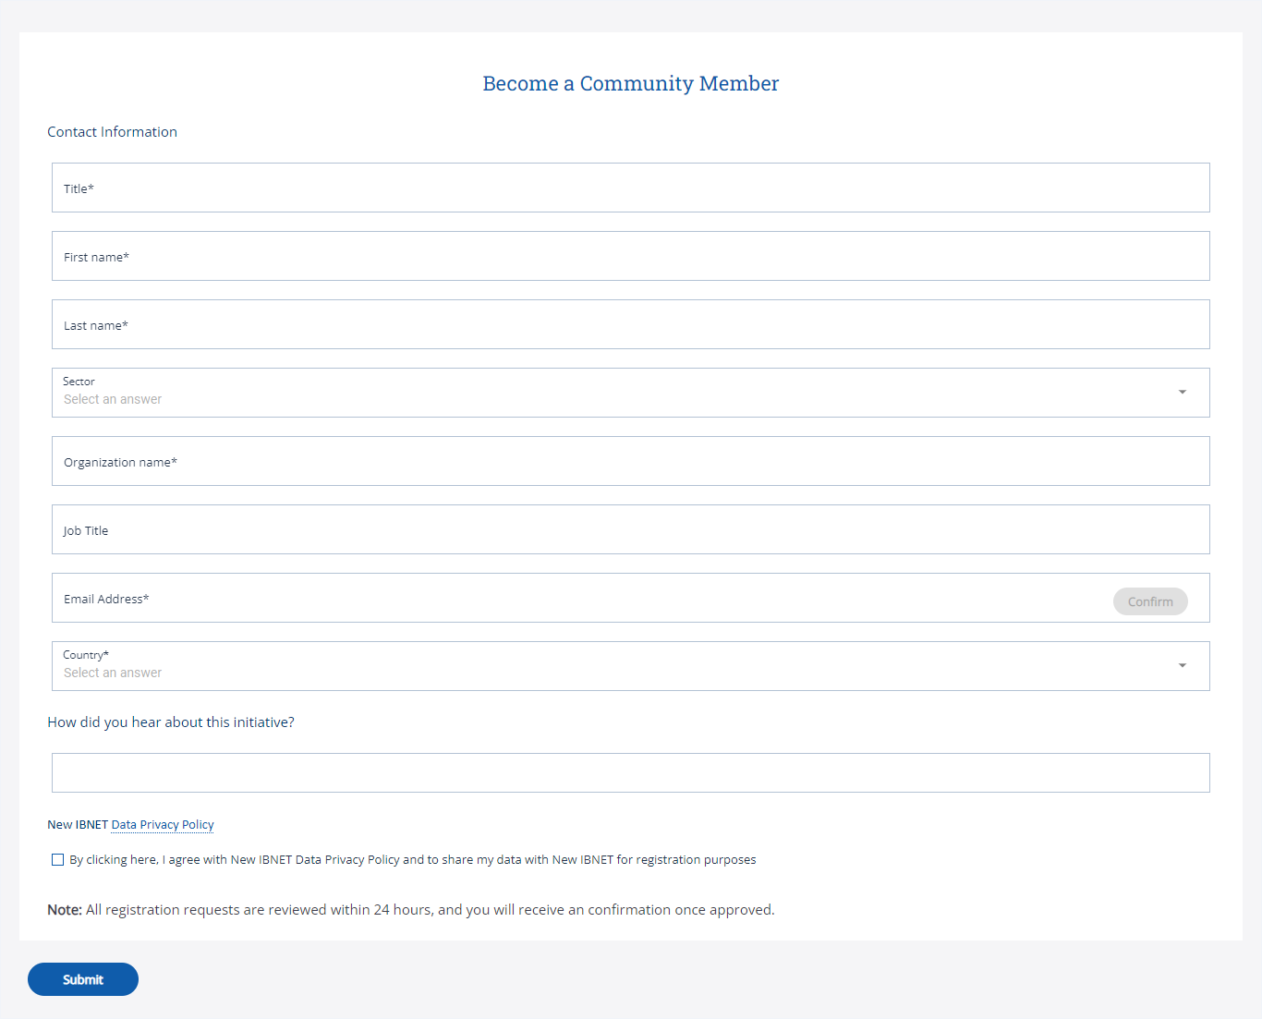
User Registration Form
https://newibnet.org/

Slide 7
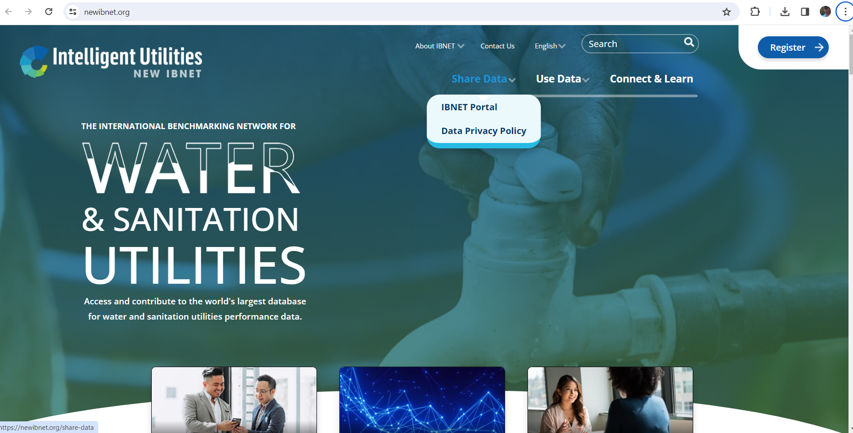
1. Main Page
https://newibnet.org/
Click and login

Slide 8
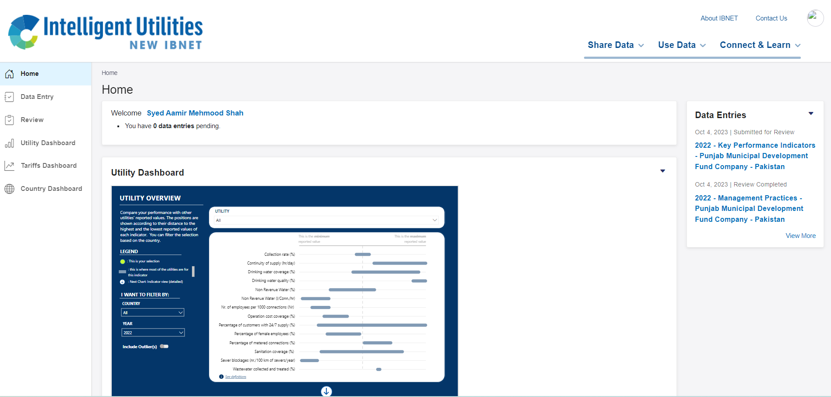
2. Dashboard
https://newibnet.org/
Data Entry Form

Slide 9
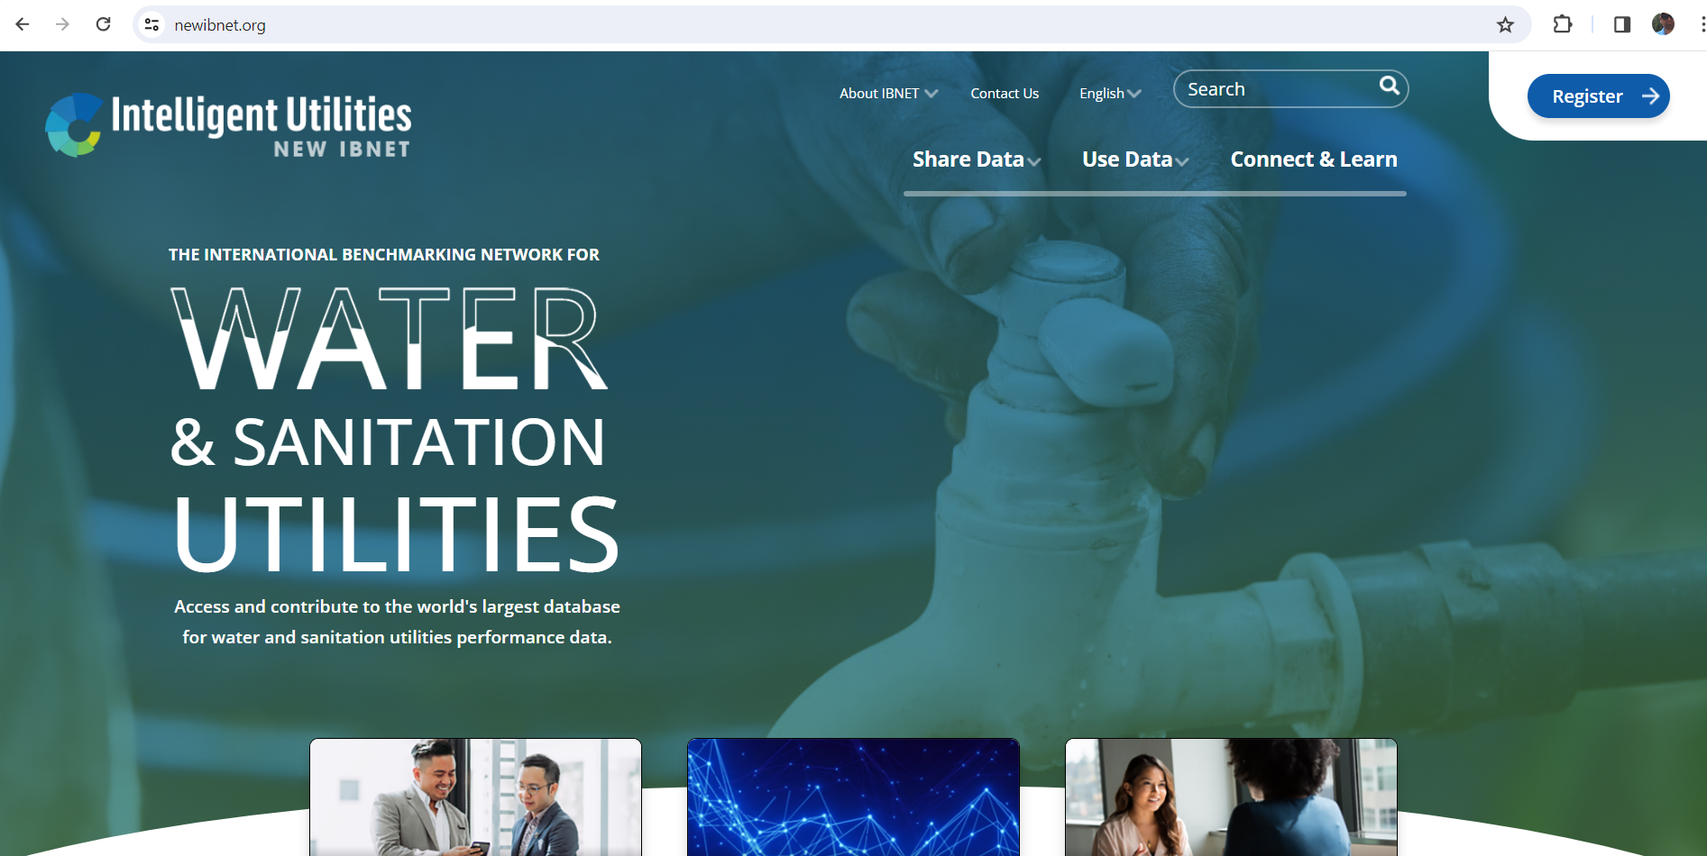
3. Dashboard
https://newibnet.org/
In case of non accessible
Click and login group
Group Name
FLEXIBLE GROUP
Pakistan - Water Supply and Sanitation

Slide 10
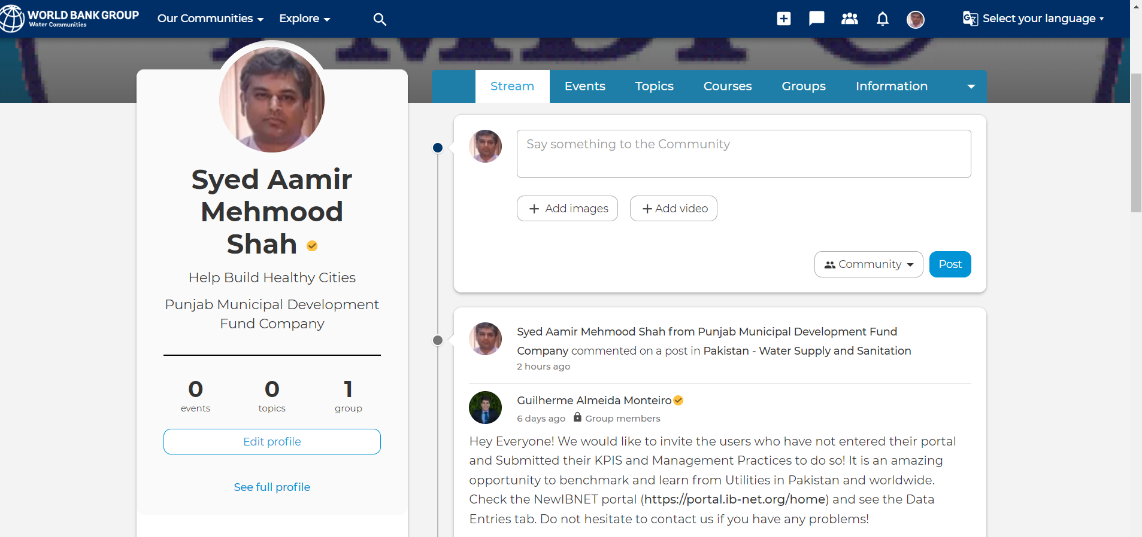
4. group
https://newibnet.org/
Click

Slide 11
4. Email
https://newibnet.org/
Click

Slide 12
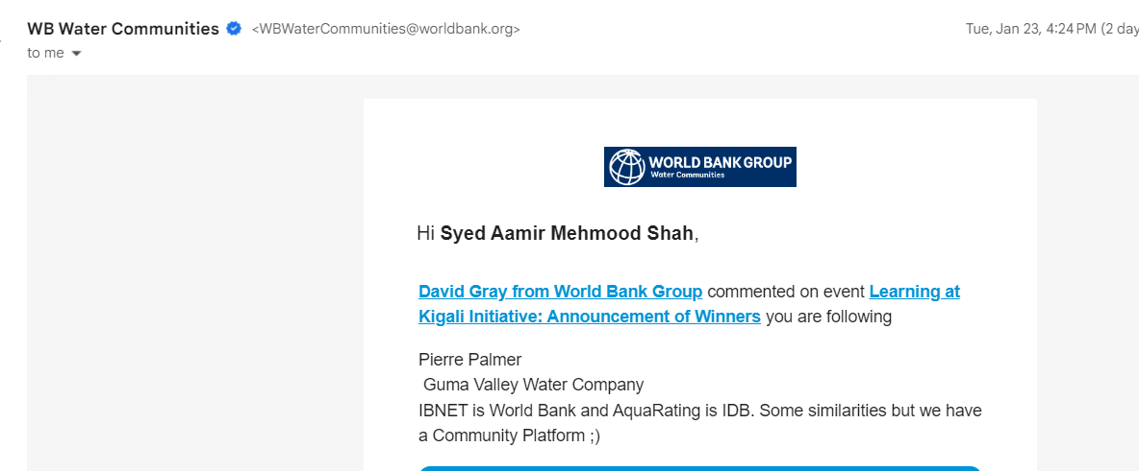
4. group
https://newibnet.org/
Email from

Slide 13
THANKS

Slide 14
Utility Indicators Performance - Forms
2.1. Drinking Water Coverage
2.1.1 What is the total population in your service area?
2.1.2 What is the population in service area provided with access to water services from the utility?
2.1.3 What is the total number of active water service connections?
2.1.3.1 What is the total number of active direct household water connections?
2.1.3.2 What is the total number of active public tap/standpoint water connections?
2.1.3.3 What is total number of active commercial, institutional, industrial and other water connections?
2.2. Continuity of supply (hours per day)
2.2.1 What is the average daily supply (hours per day)?
2.3. Percentage of people with supply 24 hour a day, seven days a week (%)
2.3.1 What is the population in service area with water services from the utility
2.3.2 Population with access to supply, 24 hours a day, seven days a week

Slide 15
Utility Indicators Performance
2.4. Non-revenue Water (l/Conn./hr and %)
2.4.1 What is the total produced water volume?
2.4.2 What is the total number of active water service connections?
2.4.3 What is the total water volume billed?
2.4.4 What is the total volume of water sold to residential customers through direct connections
2.4.5 What is the total volume of water sold to residential customers through public tap/standpoint water connections?
2.4.6 What is the total volume of water sold to commercial, institutional, industrial and other water connections?
2.4.7 What is the total length of water distribution network?
2.4.8 What was the total number of pipe breaks (resolved and unresolved)?
2.5. Sanitation coverage (%)
2.5.1 What is the total population in the service area?
2.5.2 What is the total population in service area provided with access to wastewater services from the utility?
2.5.3 What is the total number of active wastewater service connections?
2.5.4 What is the total number of active direct household wastewater connections?
2.5.5 What is total number of active commercial, institutional, industrial and other wastewater connections?

Slide 16
Utility Indicators Performance
2.6. Sewer blockages (number per 100 km of sewers per year)
2.6.1 What was the total number of blockages registered (including unresolved)
2.6.2 What is the total length of the sewerage network?
2.7. Wastewater collected and treated (%)
2.7.1 What is the volume of collected wastewater through piped sewerage system or tankers?
2.7.2 What is the volume of collected wastewater that is treated?
2.8. Revenue collection rate (%)
2.8.1 What was the total revenue billed?
2.8.2 What was the total revenue collected?
2.9. Percentage of metered connections (%)
2.9.1 What is the total number active water service connections?
2.9.2 What is the total number of metered connections?
2.10. Service complaints resolved (%)
2.10.1 What was the number of complaints received during the last calendar year?
2.10.2 What was the number of complaints resolved last calendar year ?
Notes:
Definitions: Collected Revenue: This refers to the total income received or that the Utility collected and is registered in its income for water and wastewater services provided. Please include other services such as fees for connection or reconnection of services provided. This value should include subsidies but NOT other non-service-related income streams
Billed Revenue: This refers to the total billing of water and wastewater services, connection fees, well abstraction fees, reconnection fees, and other operational revenues including subsidies, but excluding all taxes. Please include revenues of bills that were not delivered to the customers, but the Utility has it registered as bills to be collected

Slide 17
Utility Indicators Performance
2.11. Drinking water quality
2.11.1 What was the number of water quality tests performed?
2.11.2 What was the number of water tests performed that met all local guidelines?
2.12. Operation cost coverage (%)
2.12.1 What was the total revenue billed?
2.12.2 What were total operating expenses (excluding any depreciation or interest expenses)?
2.12.3 What were total labor expenses?
2.12.4 What were total energy expenses?
2.12.5 What were total other expenses (production, operational, administrative, etc.)?
2.13. Number of employees per 1,000 connections
2.13.1 What is the total number of full-time utility employees?
2.13.2 What is the total number of active water service connections?
2.13.3 What is the total number of active wastewater service connections?
2.14. Female employees (%)
2.14.1 What is the total number of full-time utility employees?
2.14.2 What is the total number of full-time female utility employees?

